Slide 1
PROBLEM STATEMENT
Anyone who has booked a flight ticket knows how unexpectedly the prices vary. The cheapest available ticket on a given flight gets more and less expensive over time. This usually happens as an attempt to maximize revenue based on -
1. Time of purchase patterns (making sure last-minute purchases are expensive)
2. Keeping the flight as full as they want it (raising prices on a flight which is filling up in order
to reduce sales and hold back inventory for those expensive last-minute expensive
purchases)
PROBLEM UNDERSTANDING
As we know covid 19 has impacted the market and we have seen changes in customer demands and behaviour. Since covid has impacted the economy badly so have seen significant changes in airline industry. Machine learning model will help customer to identify the airline fare pattern to gain maximum saving while booking the airline ticket.

Slide 2
EDA STEPS ,VISUALIZATIONS,FINALIZED MODEL AND CONCLUSION
Data Scrapping
Variable identification.
Statistical Summary of Features data.
Graphical Analysis.
Finding Important Features for Model
Dealing with Skewed Target Variable
Principal Components Analysis
Model Development and Evaluation
Checking Overfitting & Underfitting Problem
Conclusion

Slide 3
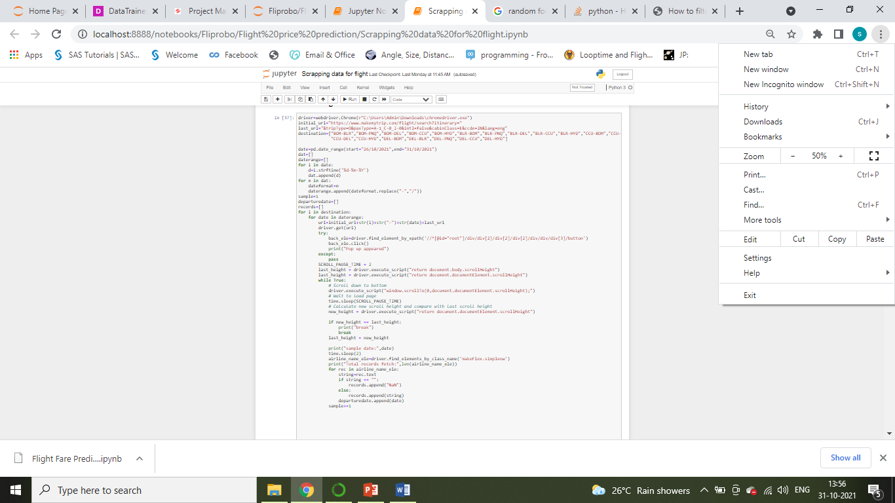
Data Scrapping
We have scrapped the data from Make My Trip Site. We have scrapped the data monthly starting from Oct 2021 to Mar 2022. For time constrained have collected data only for Bangalore, Mumbai, Kolkata and Delhi as departure city .

Slide 4
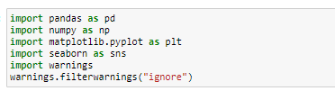
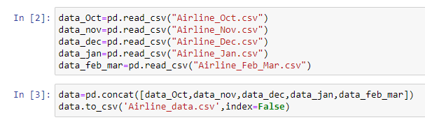
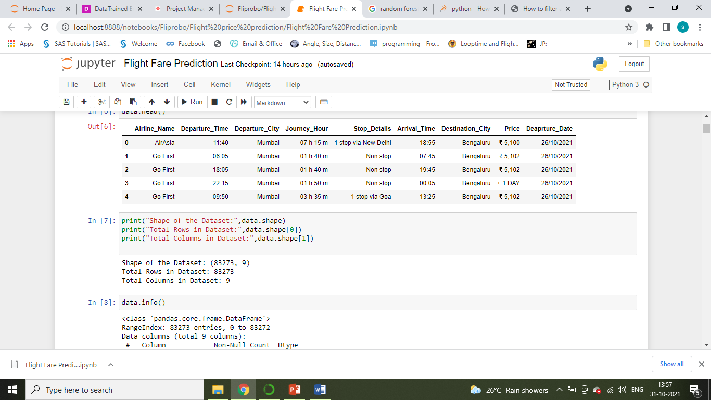
Variable identification.
Importing Libraries:
Importing Dataset:
Size of the dataset:

Slide 5
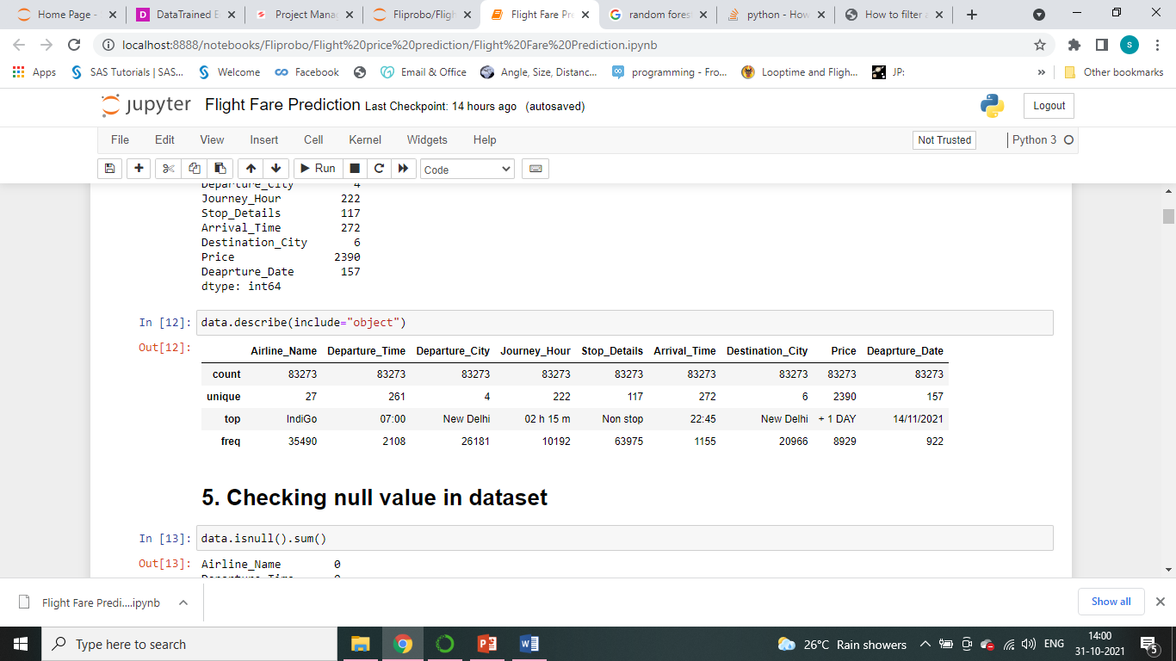
Statistical Summary of Features data.

Slide 6
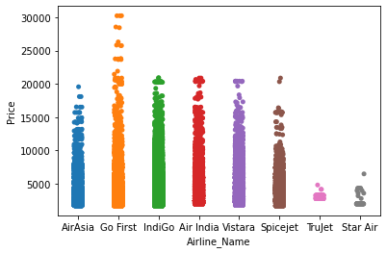
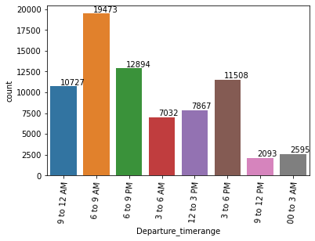
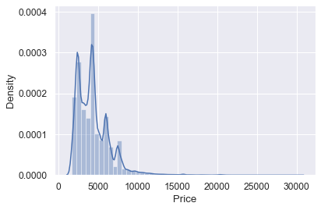
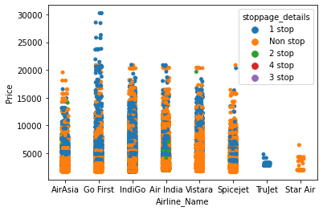
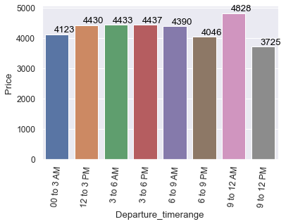
Graphical Analysis.
For analyzing Visually we have applied Univariate Analysis, Bivariate Analysis and Multivariate Analysis through various graph , chart ,plot etc.

Slide 7
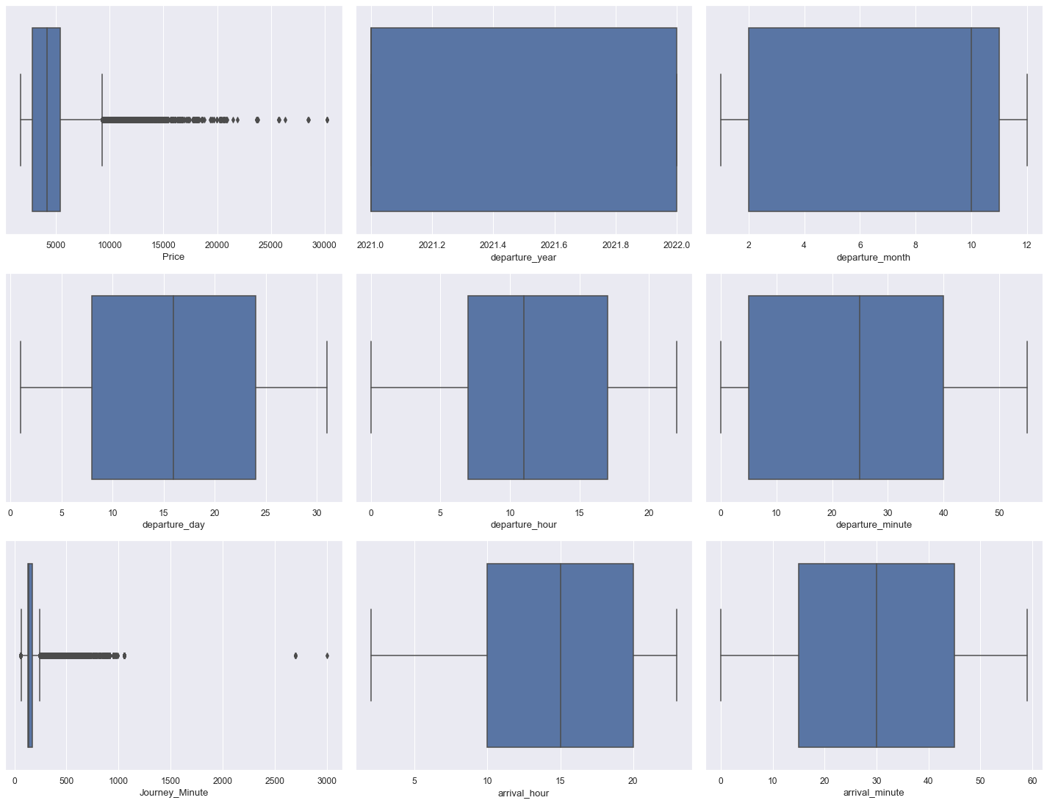
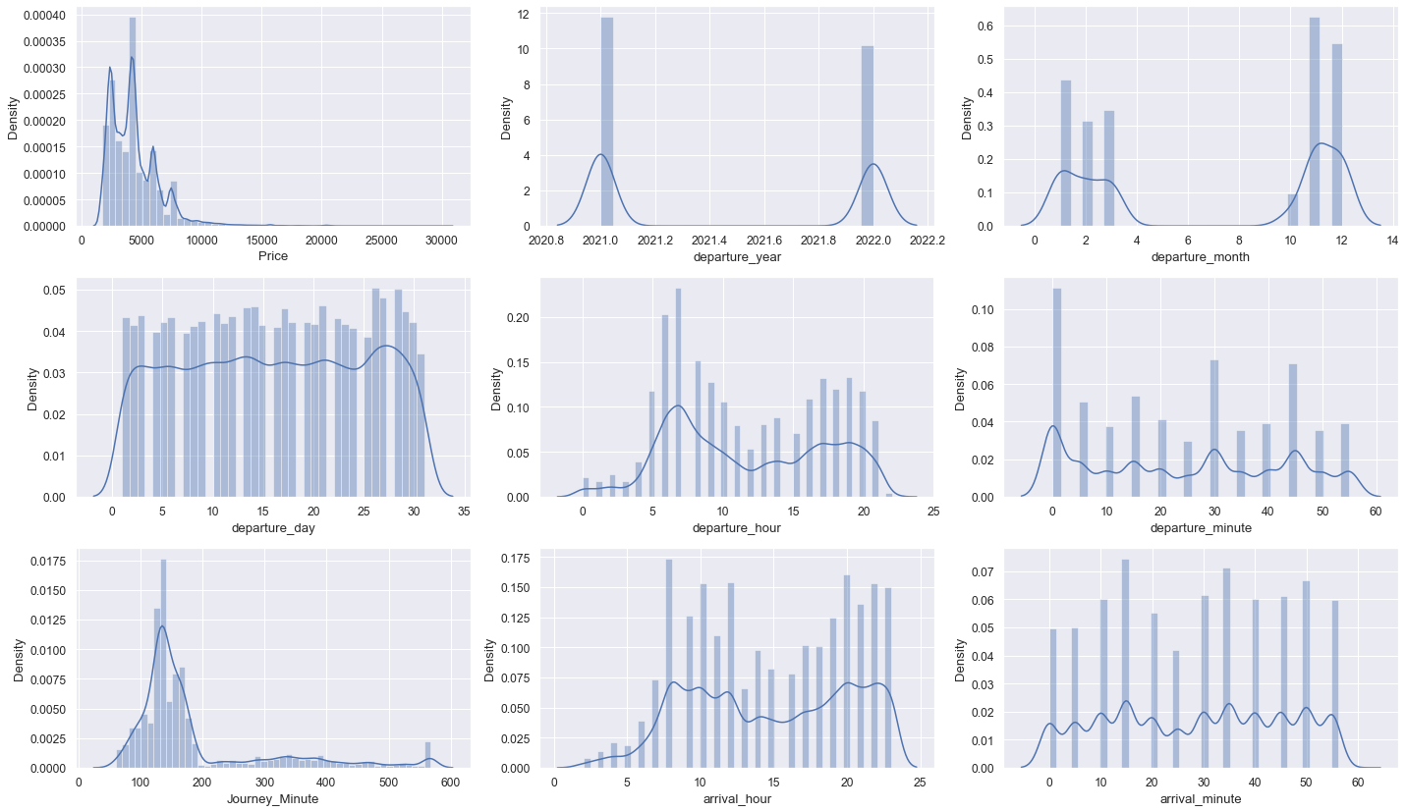
Graphical Analysis.

Slide 8
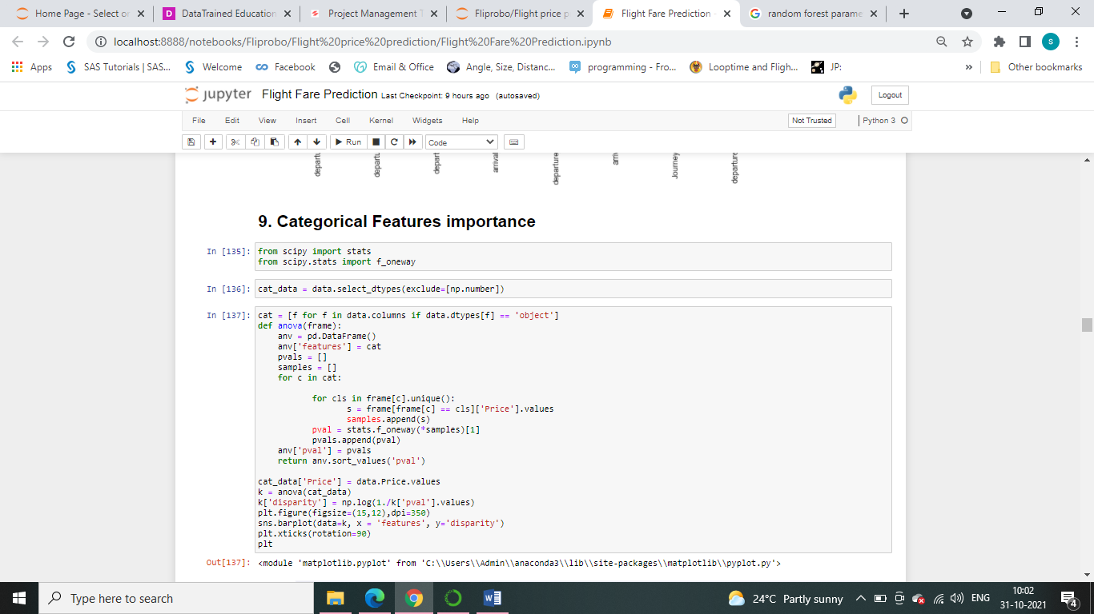
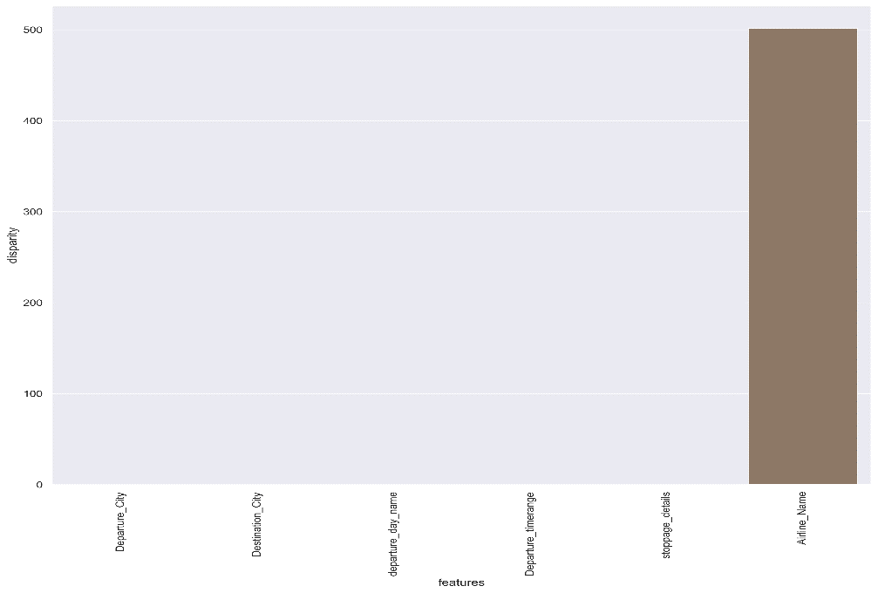
Finding Important Features for Model
Important Categorical Features:

Slide 9
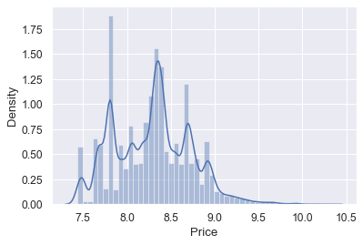
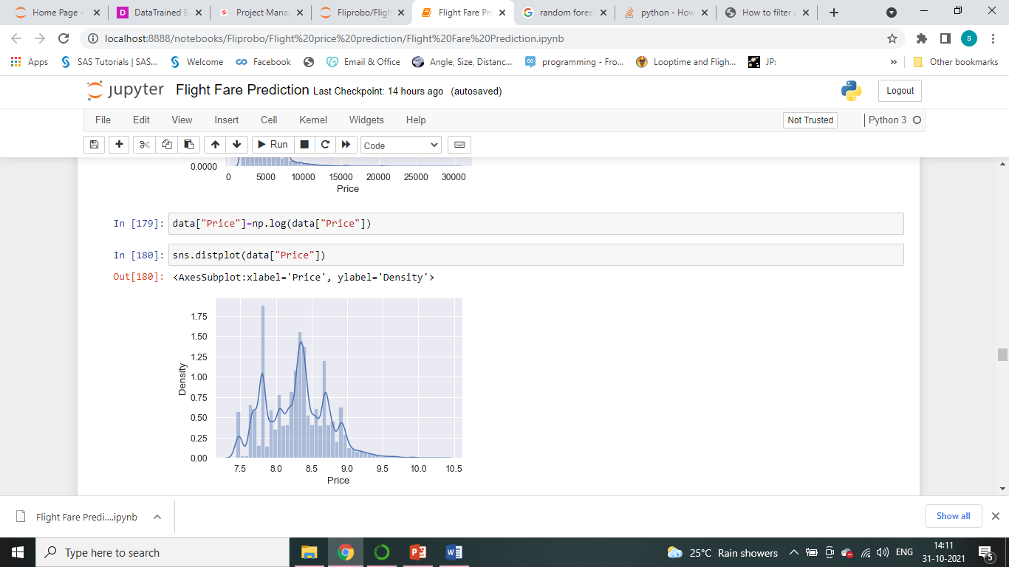
Dealing with Skewed Target Variable
Before Log Transform:
After Log Transform:

Slide 10
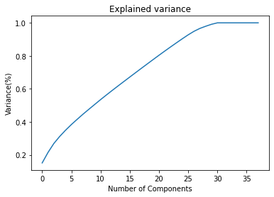
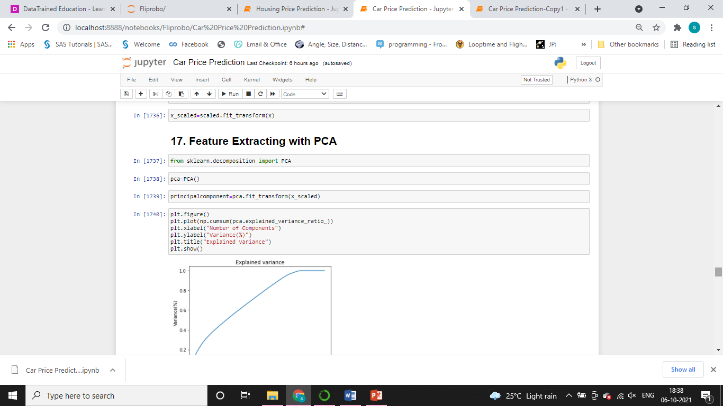
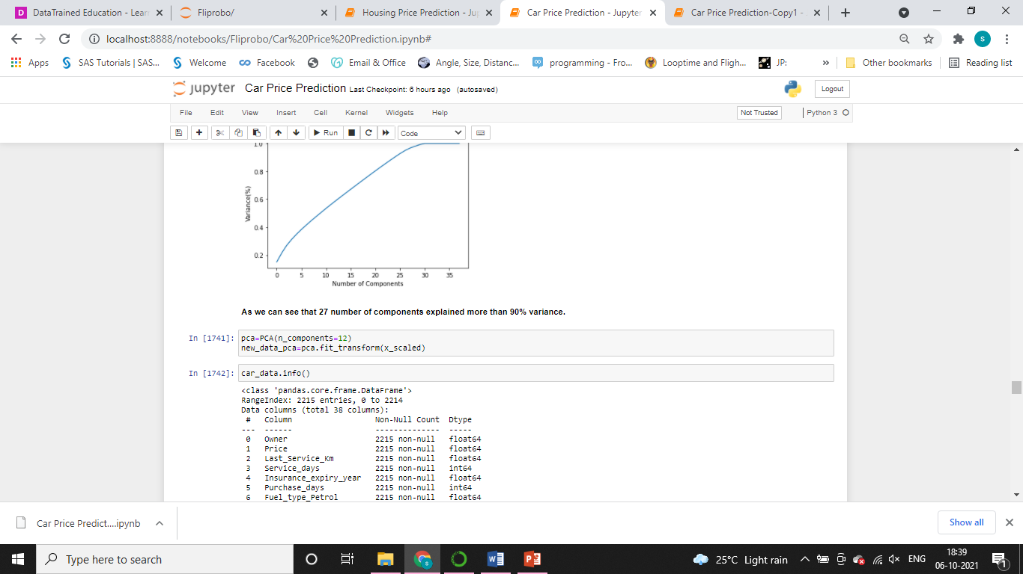
Principal Components Analysis

Slide 11
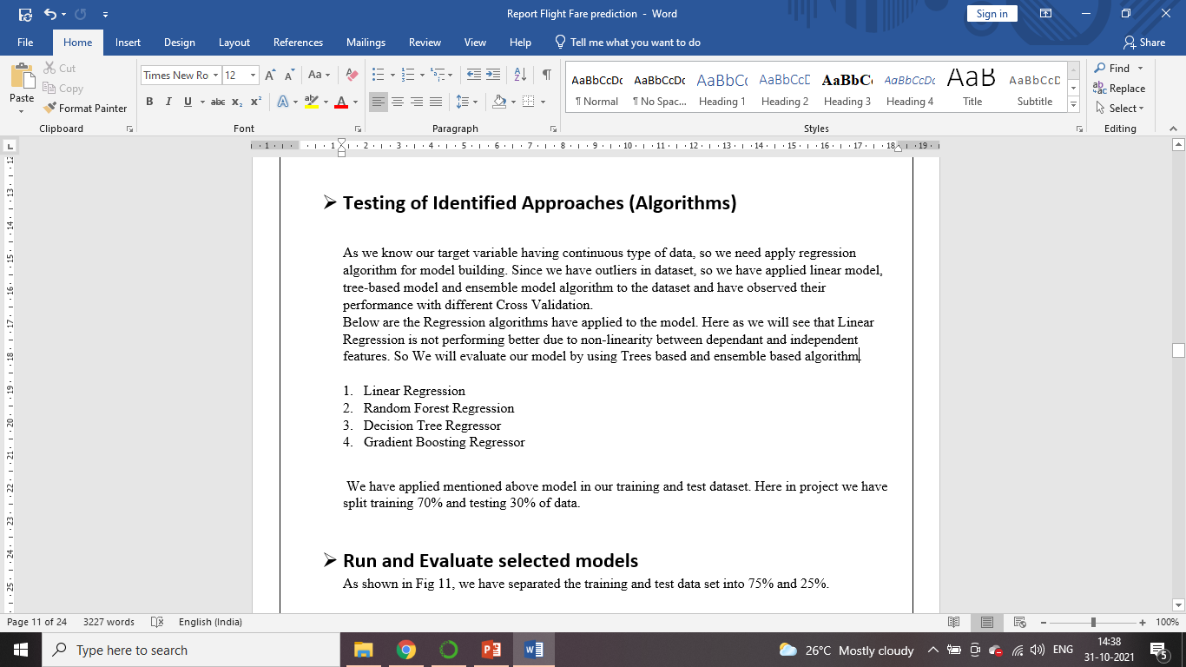
Model Development

Slide 12
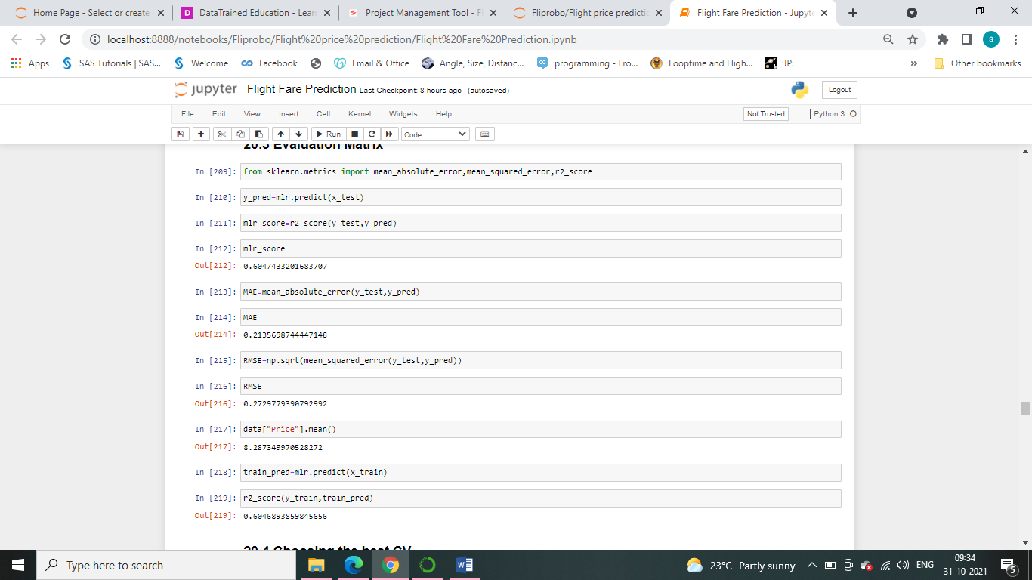
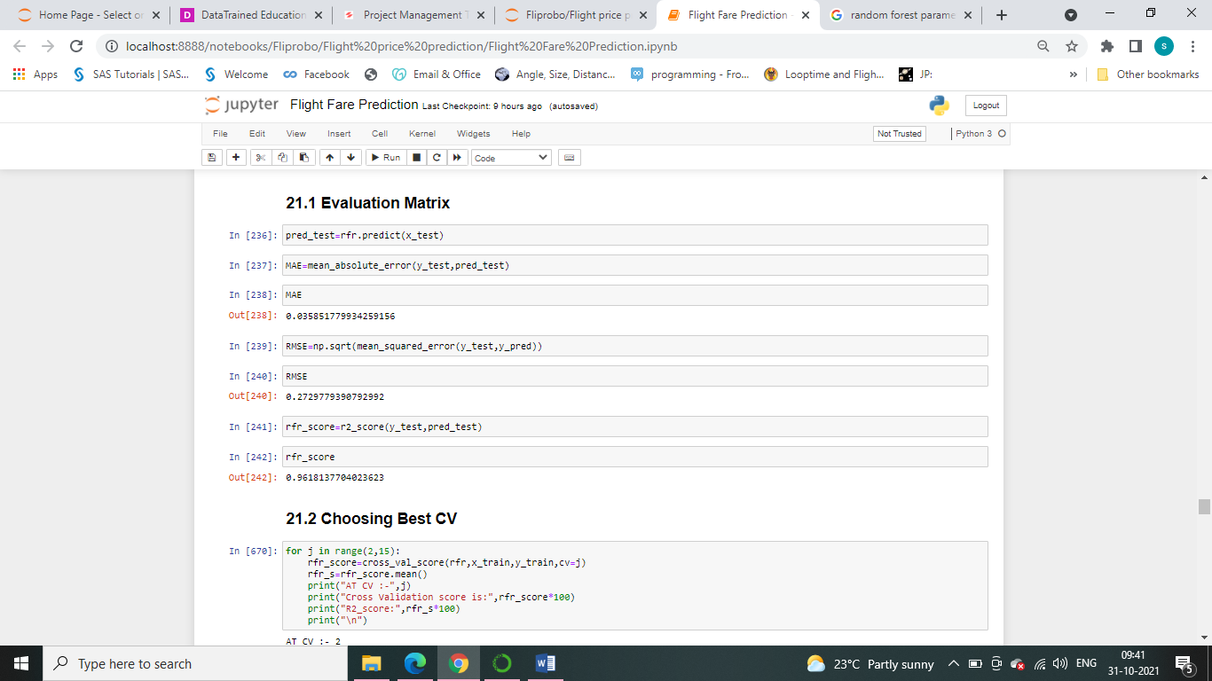
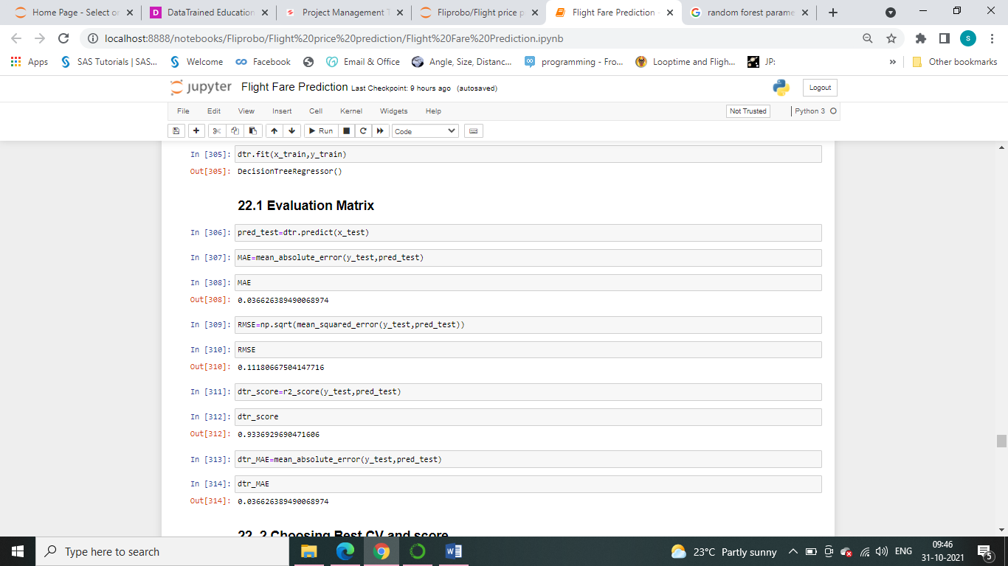
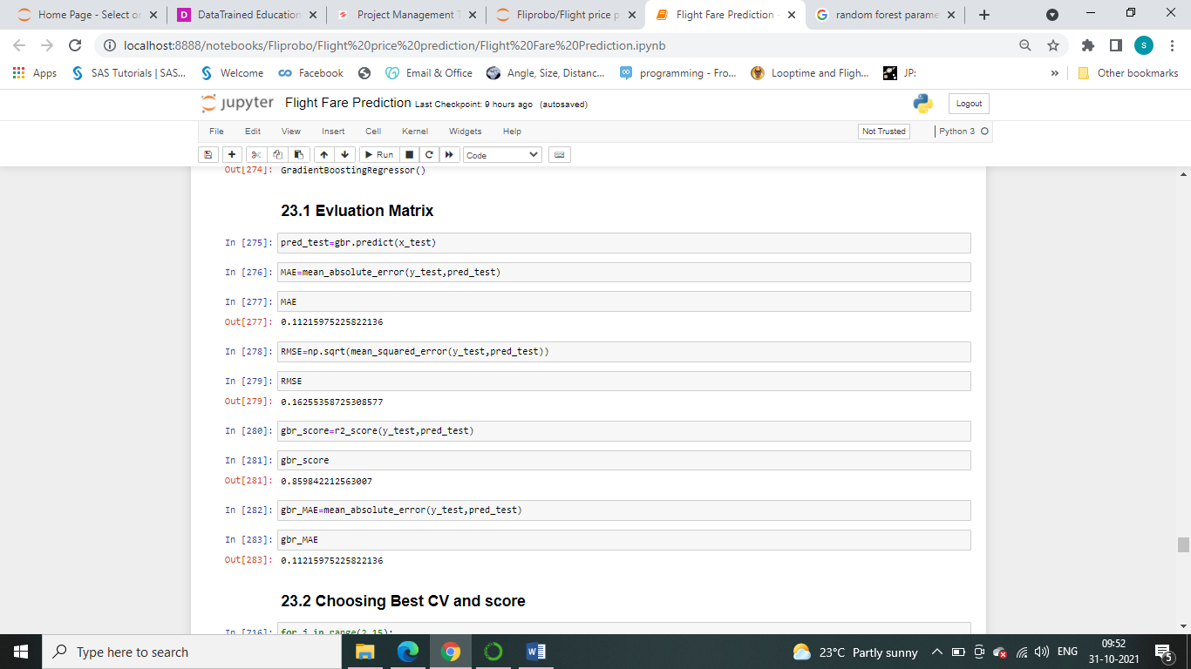
Model Evaluation:
We have evaluated model with R2 Score, Cross Validation Score and MAE error
Linear Regression
Random Forest Regressor
Decision Tree Regressor
Gradient Boosting Regressor

Slide 13
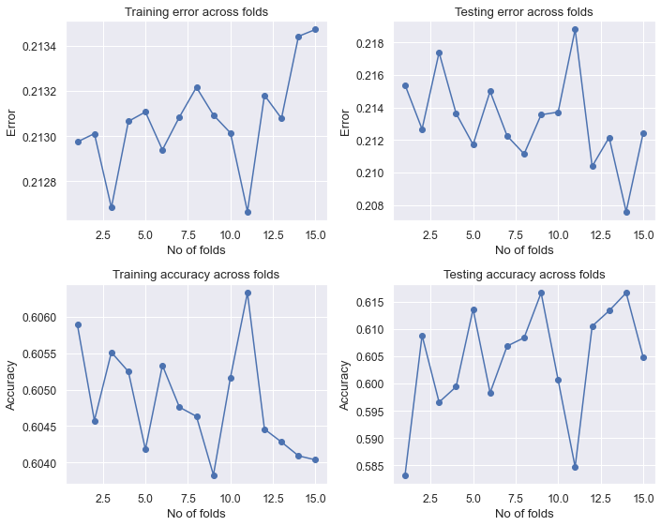
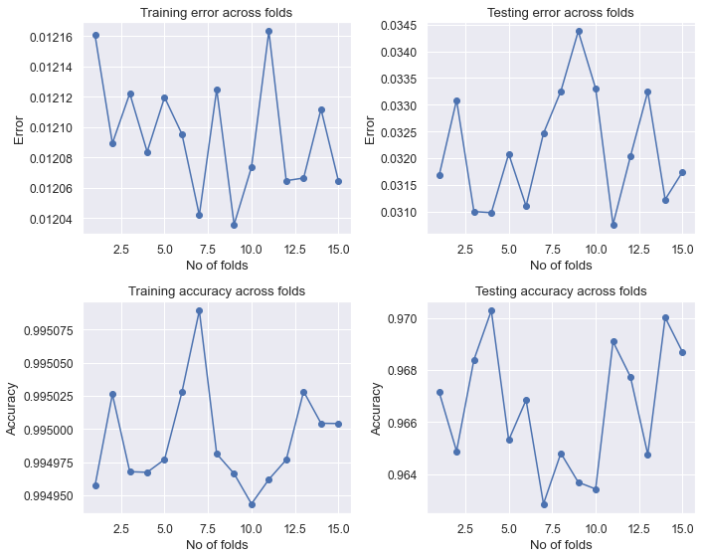
Checking Overfitting & Underfitting Problem
Linear Regression
Random Forest Regressor

Slide 14
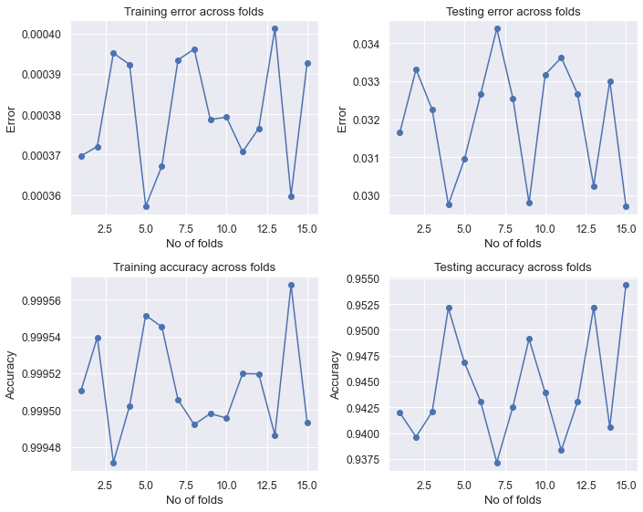
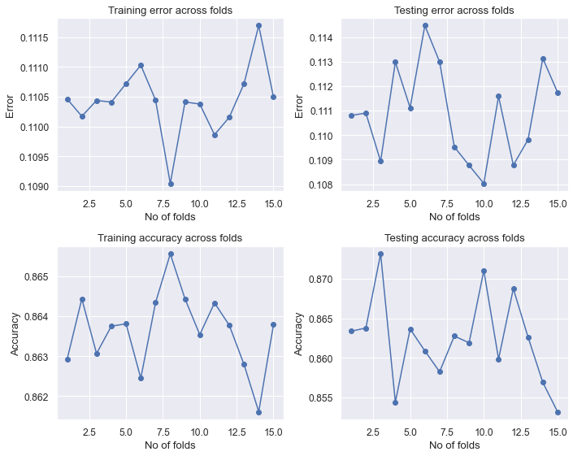
Checking Overfitting & Underfitting Problem
Decision Tree Regressor
Gradient Boosting Regressor

Slide 15
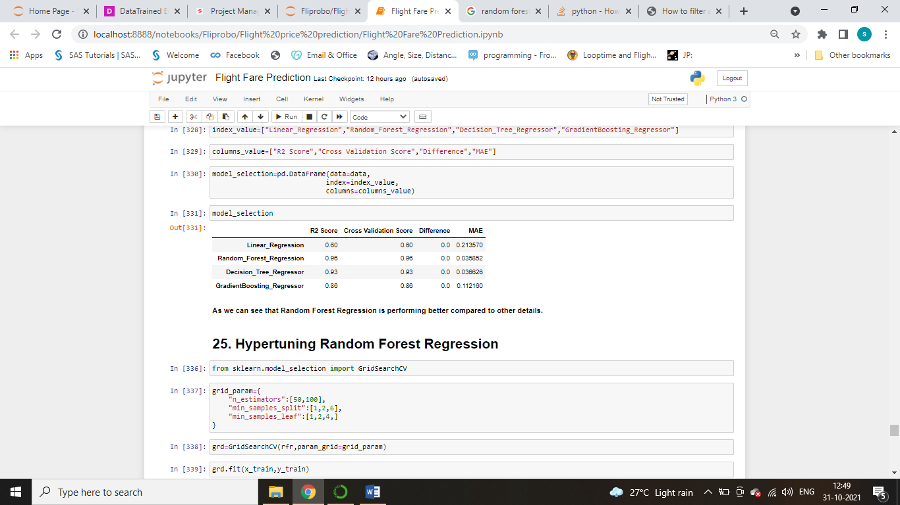
Conclusion
We have shown in Fig, Random Forest Regressor is performing better compared to Other Model.

Slide 16
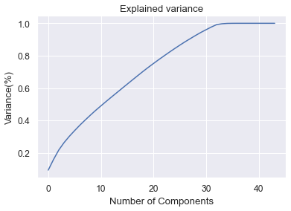
Conclusion
While doing Principal Components Analysis, as shown in Fig , we can go with 30 number of components to get more than 90% of variance explained, but we have tried the model performance without PCA applied in model.
While doing visual analysis and under EDA we have got like the some of the most important feature for prediction of Airlines ticket fare are Journey minute, Journey month and Airline name.
We have Confirmed that based on R2 Score, CV Score and MAE error Random Forest Regression Model is performing better.
At end we have found answer of some important question as mention below:

Slide 17
Which Airline Services Average Fare is high and low?
Vistara Airline is high and Star Air is less.
Which Airline having Maximum number of flights running domestically?
IndiGo
What is the peak time of travelling by customer in flight?
6 to 9 AM and 6 to 9 PM
From Which City the maximum flights are running?
New Delhi
Maximum No. of Stoppage of domestic Airlines Services.
Non-Stop Type

Slide 18
Which City Airlines ticket are most expensive and cheapest?
Expensive- Kolkata
Cheapest- Bangalore
How the stoppages impact on Airlines fare?
Fare is high for 1 and 2 type Stoppage
Fare is low for Non-Stoppage type.
Which Airlines service having more option of stoppages?
Air India
Which day Airlines ticket are cheaper than other days in week?
Wednesday and Thursday
Which day Airline ticket are expensive in week?
Saturday and Sunday
Best time to book ticket for getting lowest price?
Before 3 months

Slide 19
THANK YOU

